Slide 1

Patient Survival Prediction:
Introduction
David Daniel Streuli

Slide 2
Description of the Original Data
David Daniel Streuli

Slide 3
The Dataset
Author | Mitisha Agarwal
URL | https://www.kaggle.com/dsv/2972359
DOI | 10.34740/KAGGLE/DSV/2972359
Year | 2021
Number of rows | 91713
Number of columns | 85
Integer | 60
Decimal | 13
String | 7
Other | 5
David Daniel Streuli

Slide 4
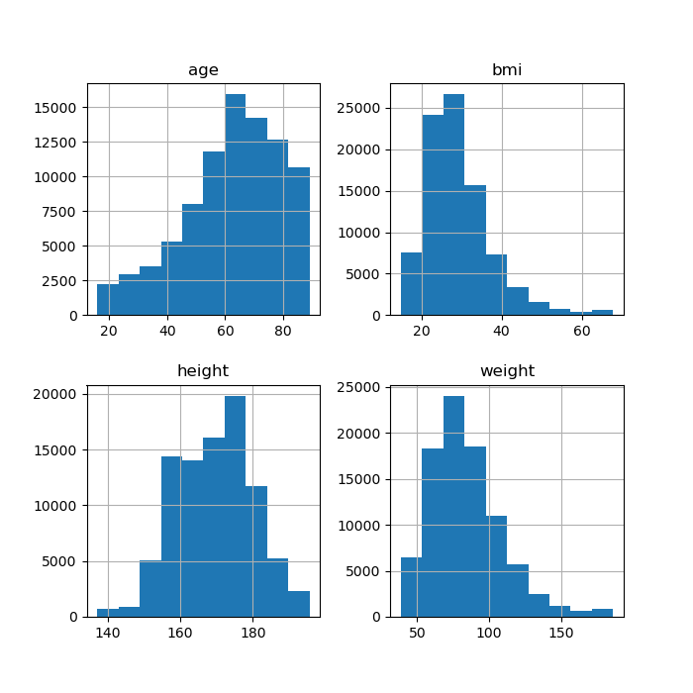
David Daniel Streuli

Slide 5
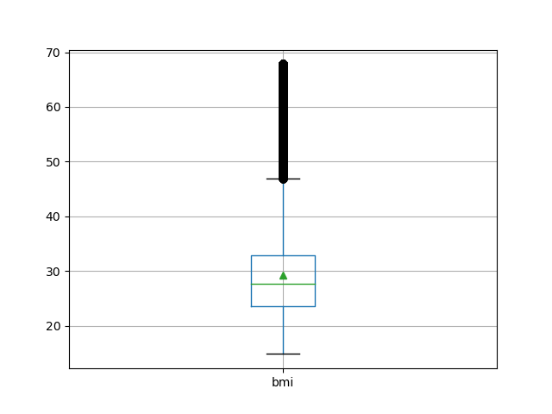
BMI boxplot
David Daniel Streuli

Slide 6
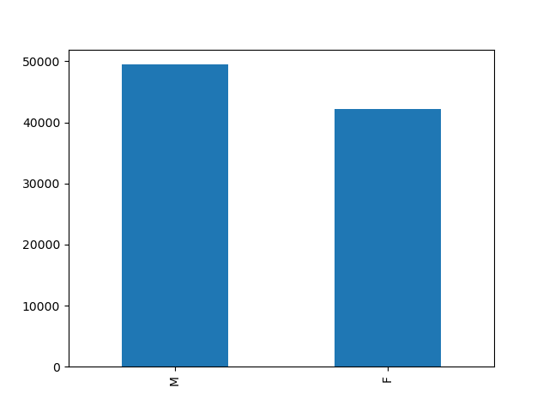
Sex Distribution
David Daniel Streuli

Slide 7
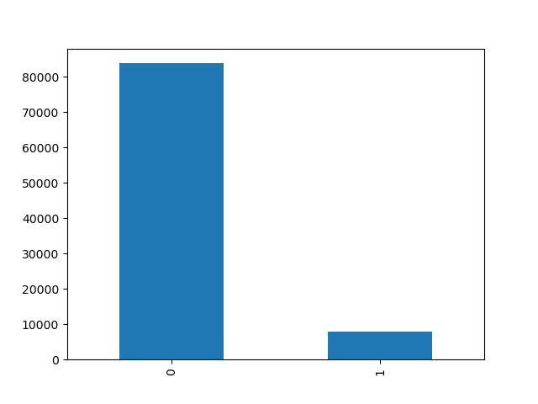
Hospital Deaths
David Daniel Streuli

Slide 8
Description of the Pre-processing of the Data
David Daniel Streuli

Slide 9
Deletion of Columns
Drop IDs: encounter_id, patient_id
Drop features with few occurrences: aids
David Daniel Streuli

Slide 10
Outlier and Error Detection
Problem: unclear if sampling error or outlier
Solution: Drop them
David Daniel Streuli

Slide 11
Outlier and Error Detection
How did we define an outlier?
(df[column] > df[column].mean()+2 * df[column].std()) & (df['hospital_death'] != 1.0)
David Daniel Streuli

Slide 12
Data Imputation
Correlation between height and weight:
do regression to fill in missing values
Since some rows are missing both values, we fill in the remaining ones with the mean.
David Daniel Streuli

Slide 13
Data Imputation
Calculate missing bmi values according to the usual calculation of the body mass index
def bmi(weight, height):
return weight / ((height/100)**2)
David Daniel Streuli

Slide 14
Data Imputation
Remaining columns:
convert one hot encoding columns from 1/0 to True/False.
Fill in missing values with mean
David Daniel Streuli

Slide 15
Final Dataset After Pre-Processing
Number of rows | 26691
Number of columns | 81
Integer / Boolean | 57
Decimal | 13
String | 7
Other | 4
David Daniel Streuli

Slide 16
Evaluation criteria of data mining models

Slide 17
Data Usage
Training Data: 70%
Evaluation Data: 30%
Ramon Ribas Domingo

Slide 18
Evaluation metric
Accuracy
Problem: unbalances
Ramon Ribas Domingo

Slide 19
Execution of different machine learning methods

Slide 20
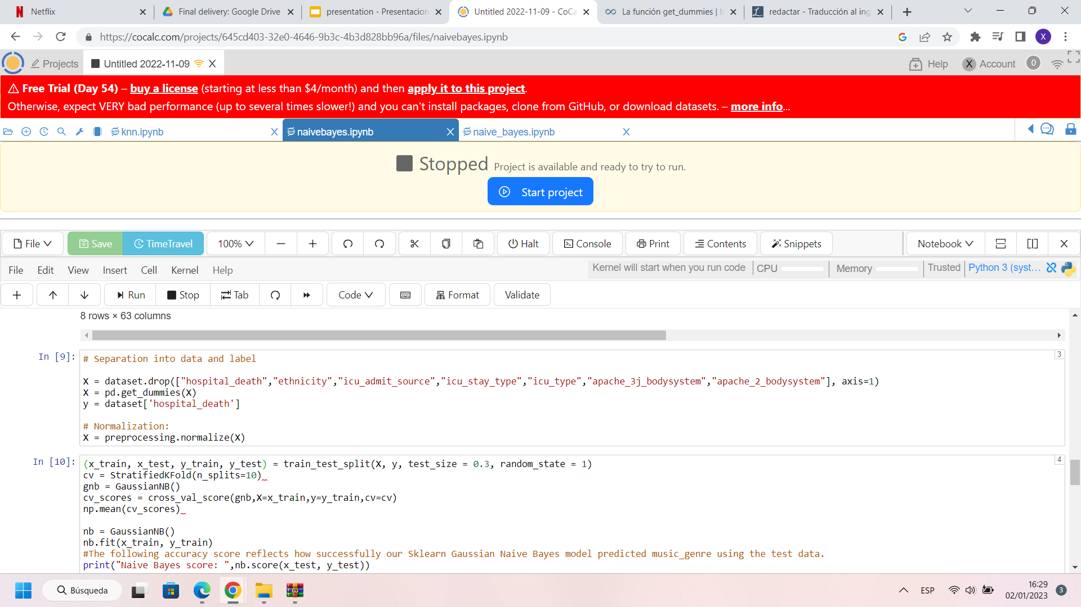
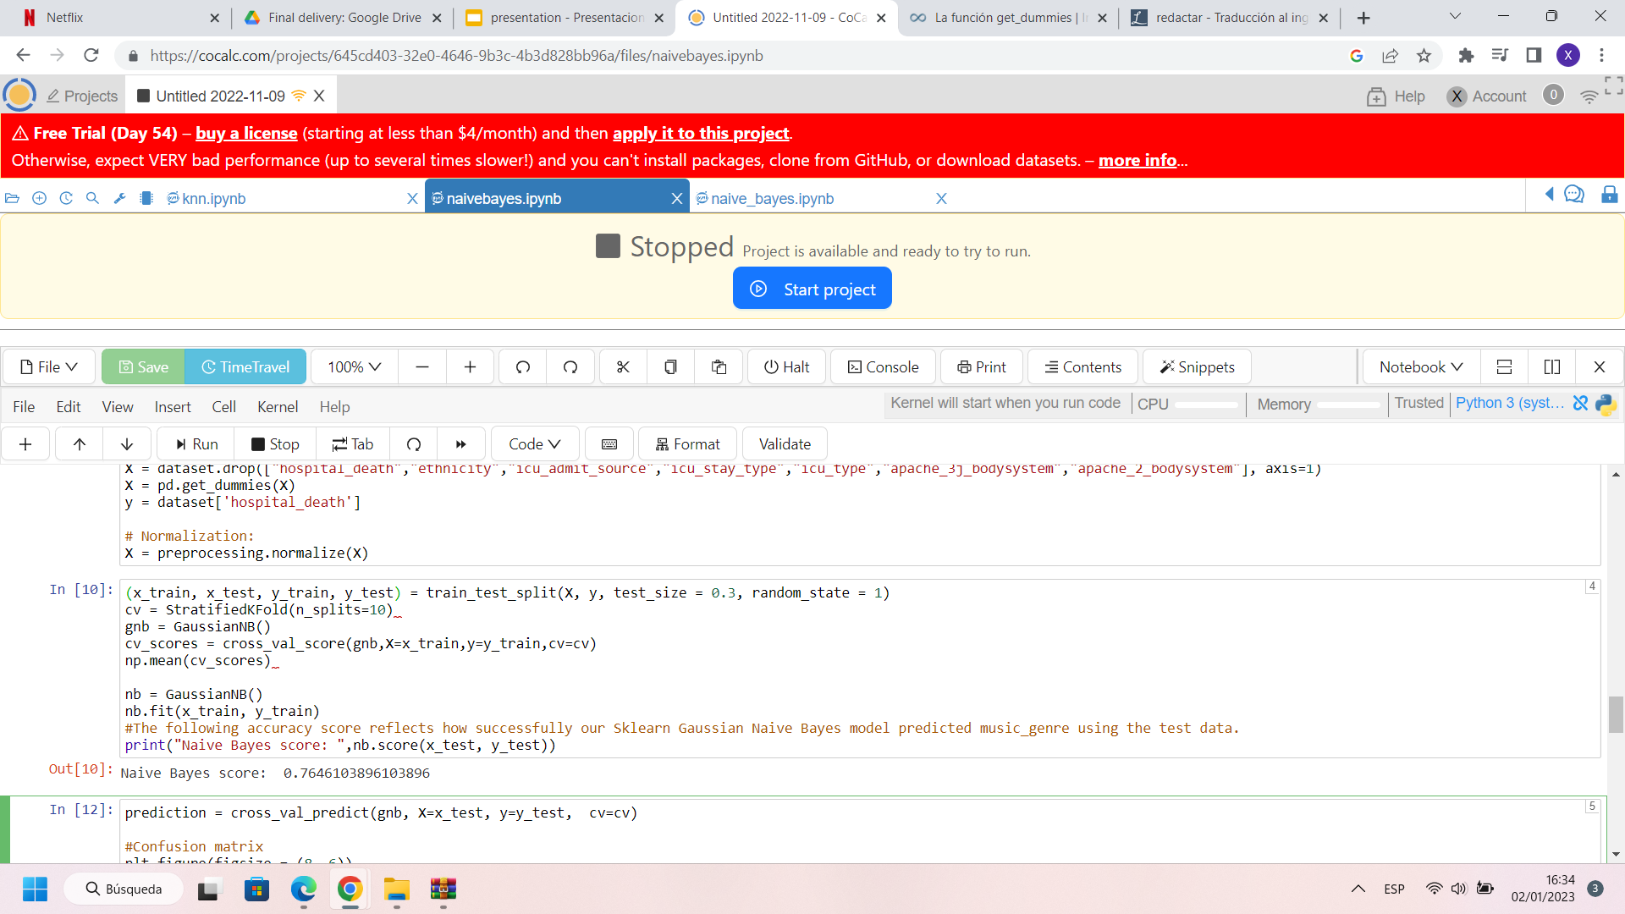
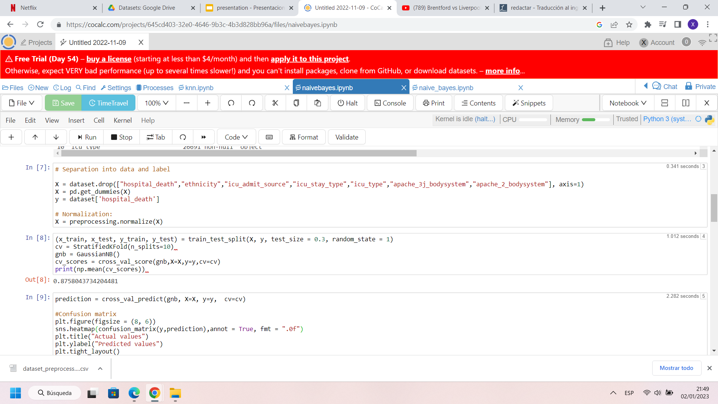
Naïve Bayes
P(A|B) = P(B|A) * P(A) / P(B)
P(y|x1,...,xn) = P(x1|y)*...*P(xn|y)*P(y) / (P(x1)*...*P(xn))

Slide 21
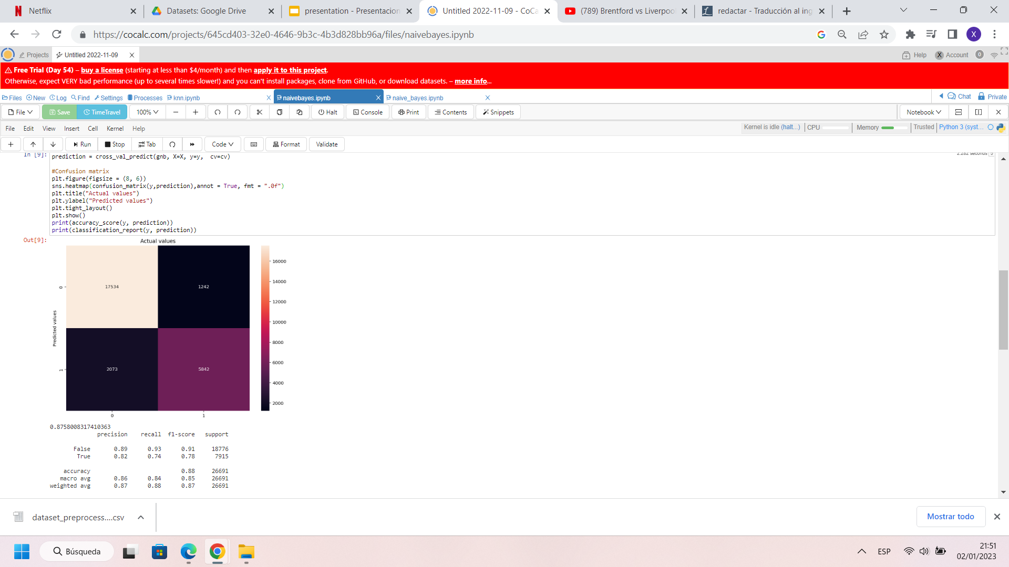
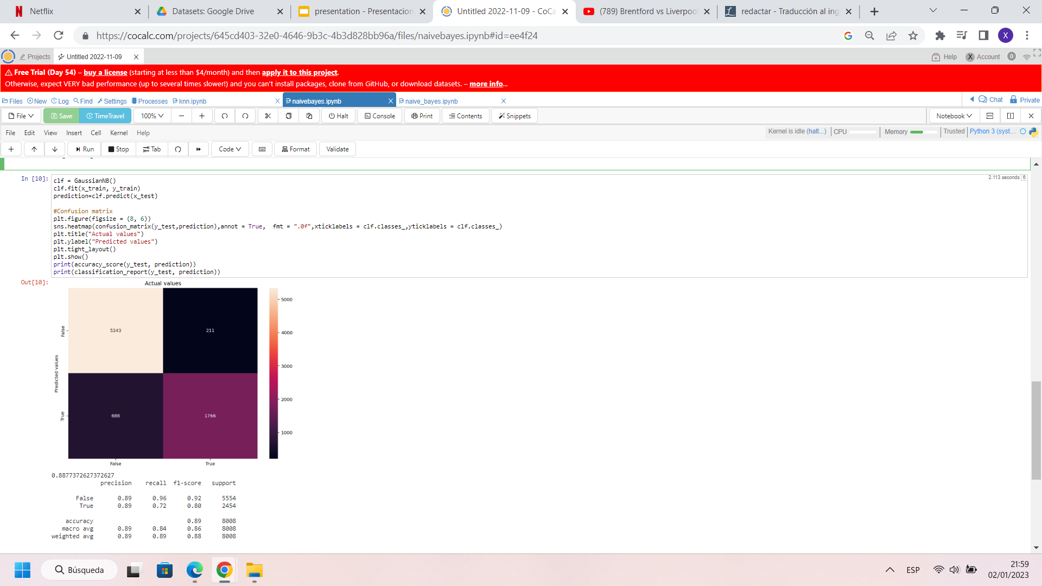
Naïve Bayes

Slide 22

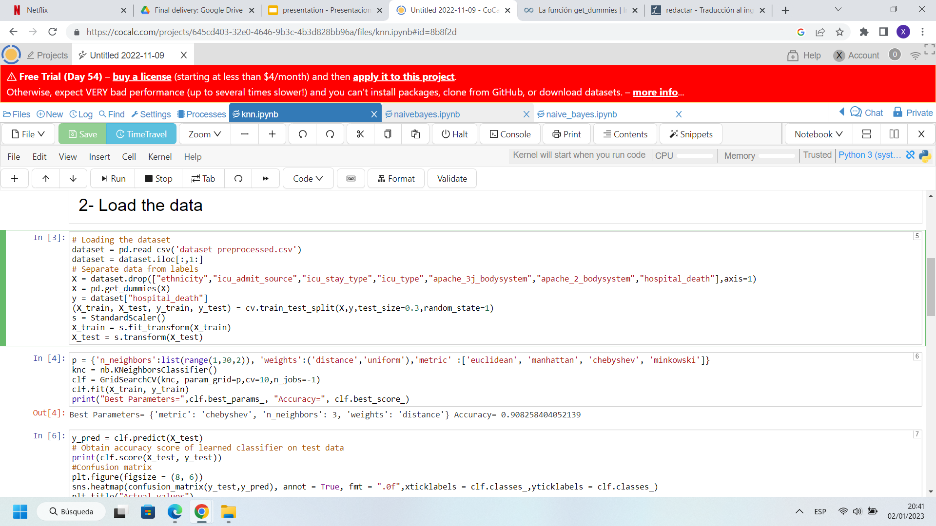
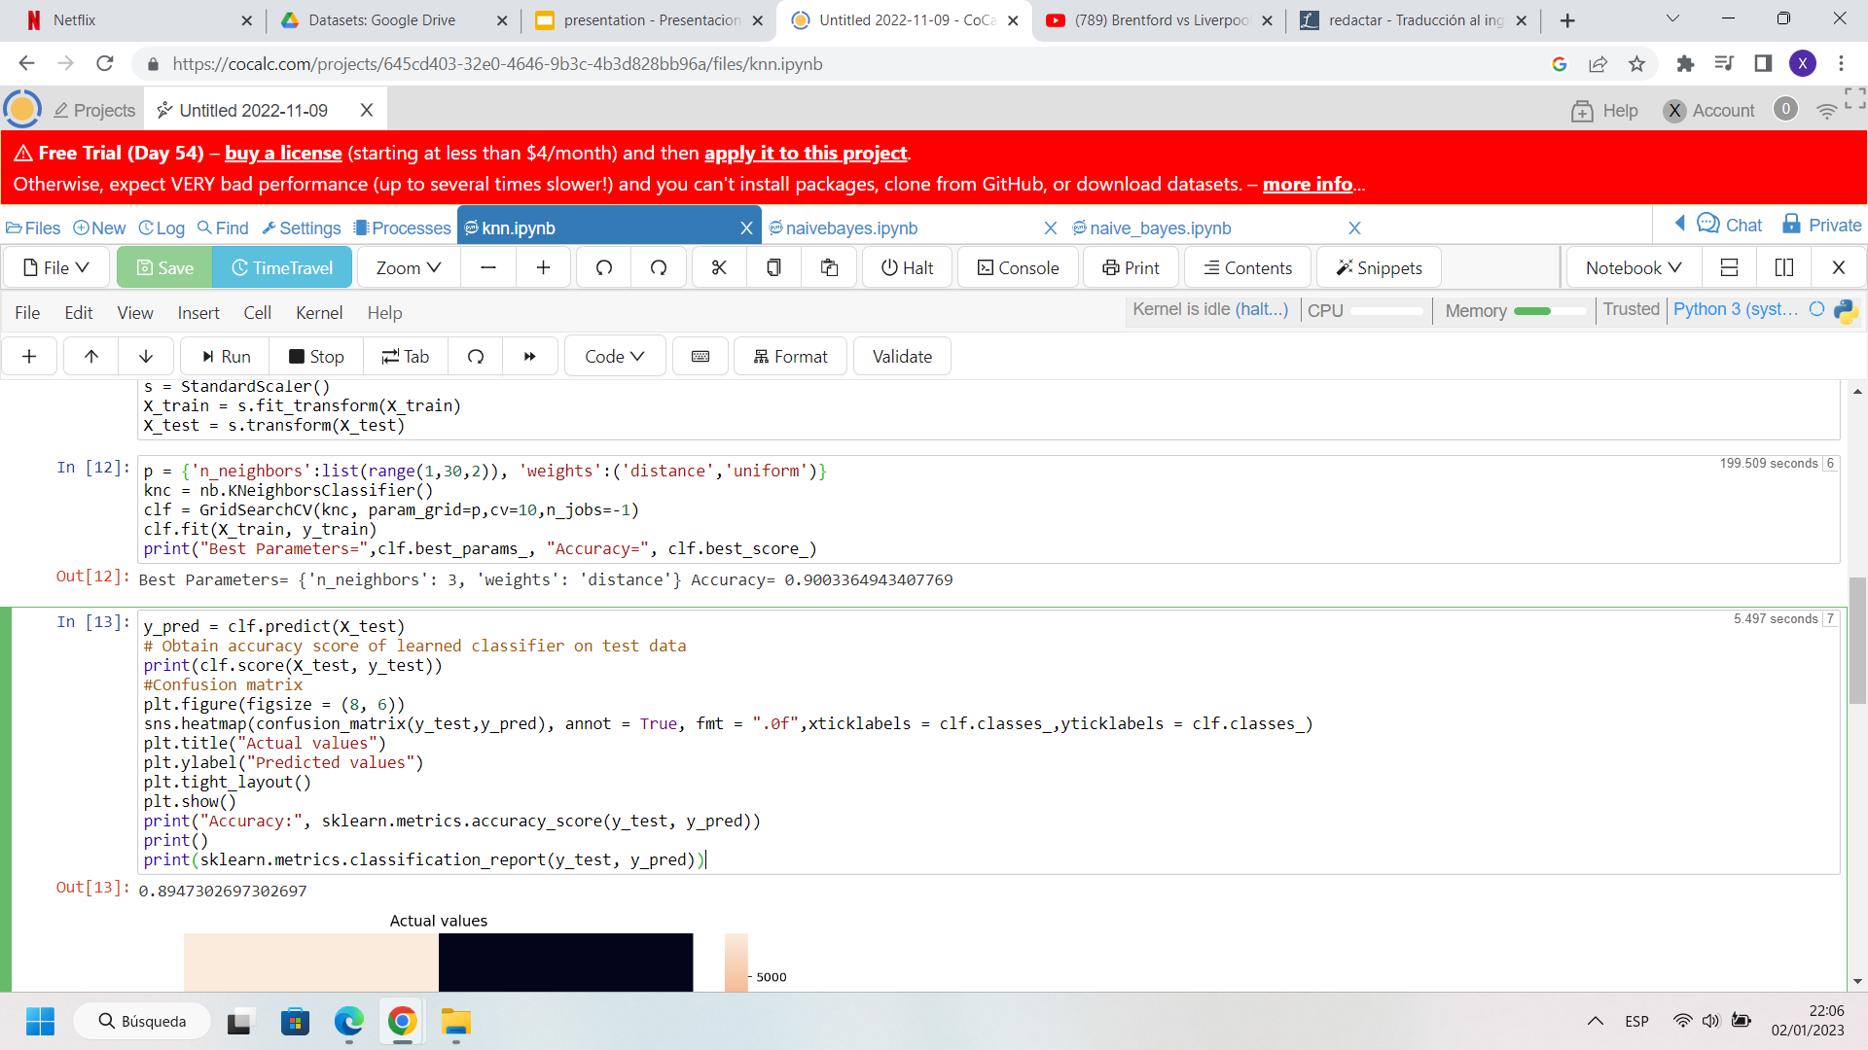
K-NN

Slide 23
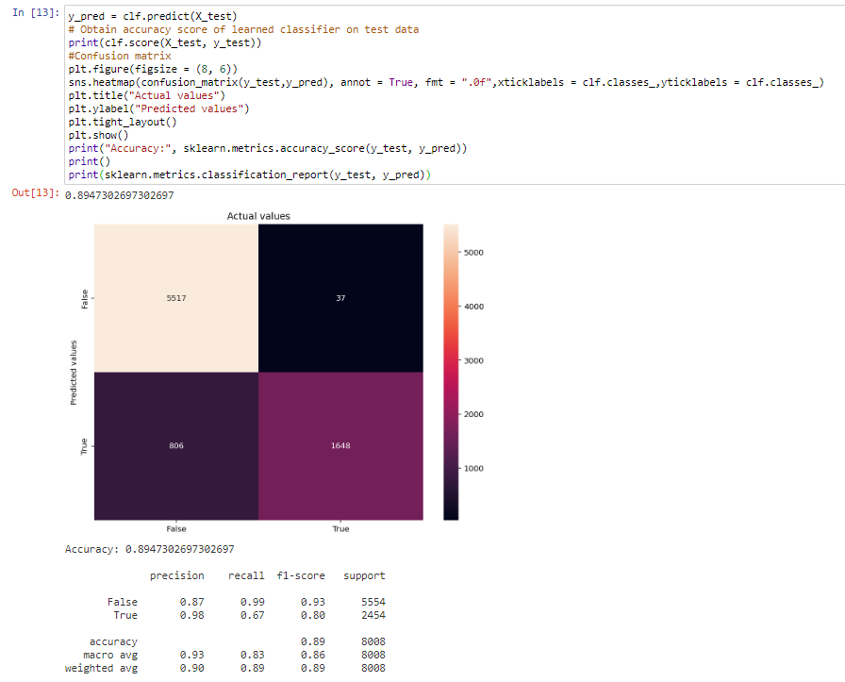
K-NN

Slide 24
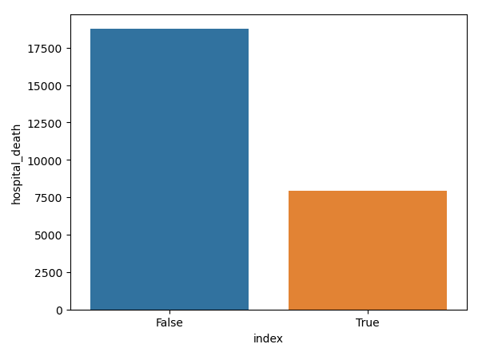
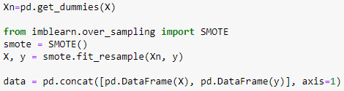
Decision trees
Mario Font Blanc

Slide 25
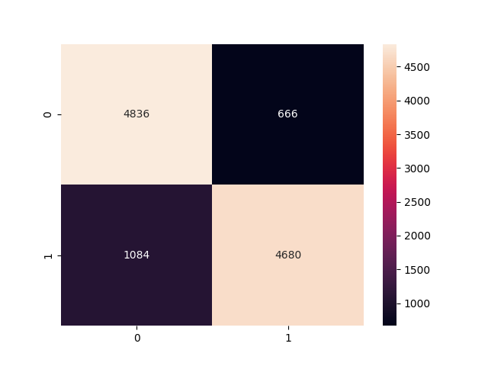
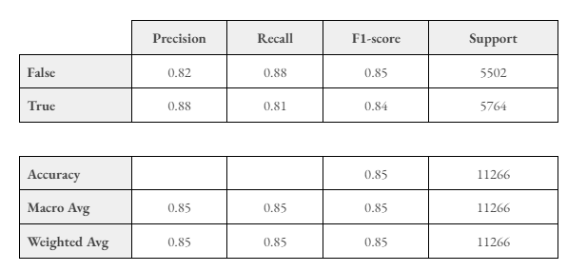
Decision trees
Mario Font Blanc

Slide 26
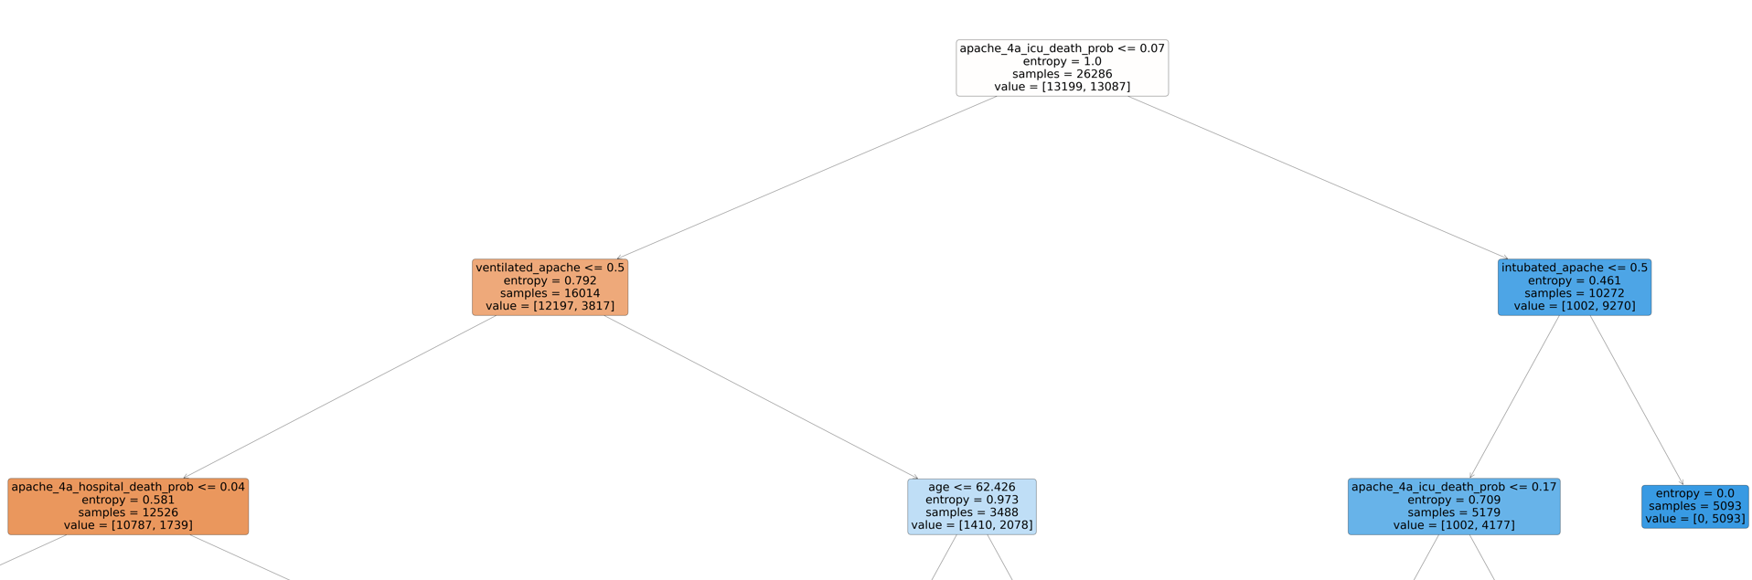
Decision trees
Mario Font Blanc

Slide 27
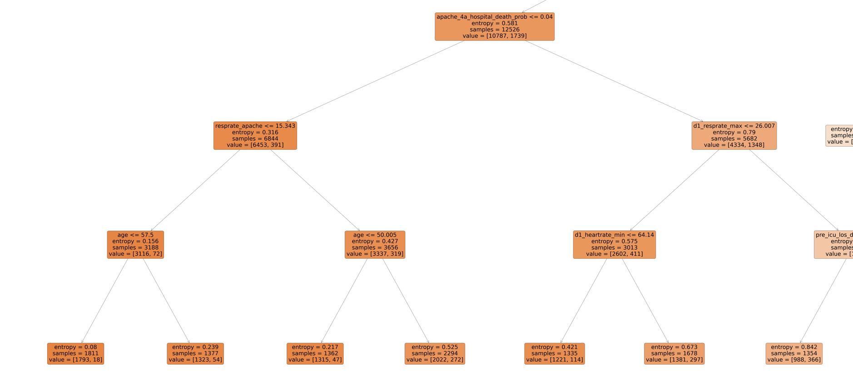

Slide 28
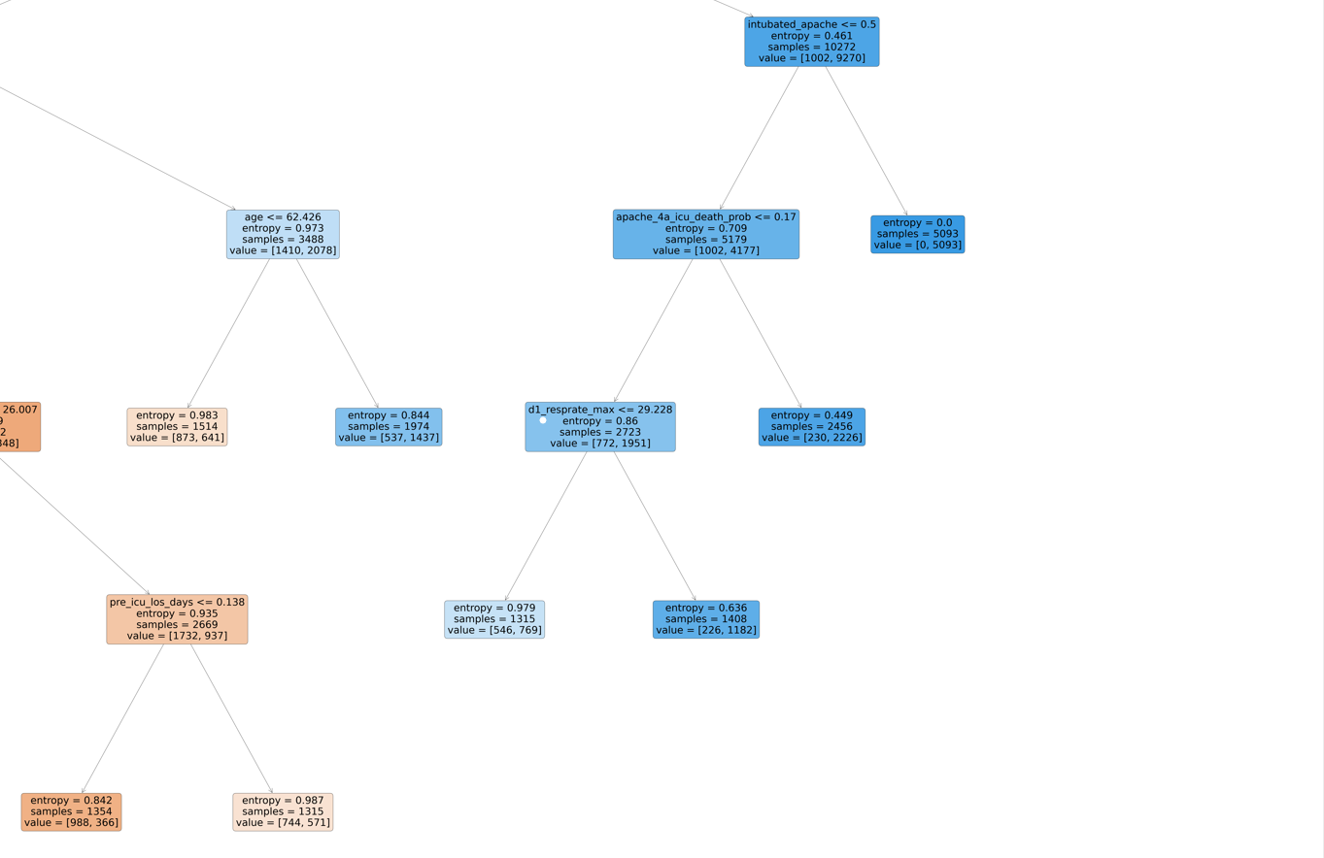

Slide 29
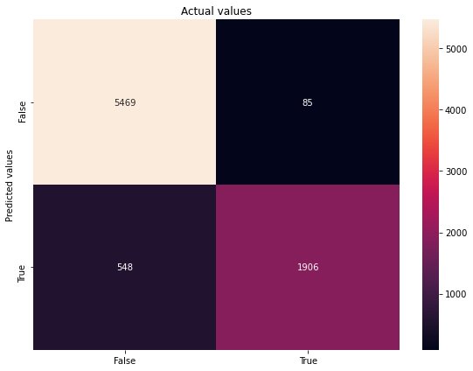
SVM
Linear SVM
Accuracy 0.9205
Nº of supports 3921
( 3885 of them have slacks)
Prop of Supports: 0.2098
Default Parameters: C = 1
Ramon Ribas Domingo

Slide 30
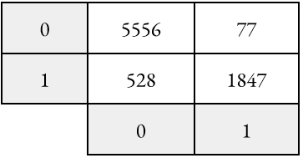
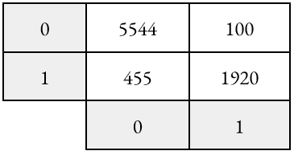
SVM
Polynomial Kernel with degree 2
Default Parameters:
C = 1
Optimal Found:
C = 10
Accuracy 0.9307
Nº of supports 3234
( 2343 of them have slacks)
Prop of Supports: 0.1731
Accuracy 0.9244
Ramon Ribas Domingo

Slide 31
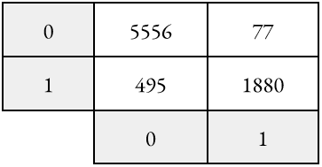
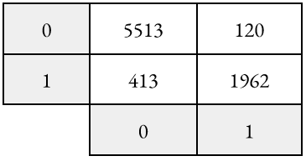
SVM
Polynomial Kernel with degree 3
Default Parameters:
C = 1
Optimal Found:
C = 10
Accuracy 0.9334
Nº of supports 3356
( 1511 of them have slacks)
Prop of Supports: 0.1731
Accuracy 0.9244
Ramon Ribas Domingo

Slide 32

SVM
RBF SVM
Accuracy 0.9360
Nº of supports 3415
( 3251 of them have slacks)
Prop of Supports: 0.1827
Default Parameters:
C = 1
gamma = 1
Ramon Ribas Domingo

Slide 33
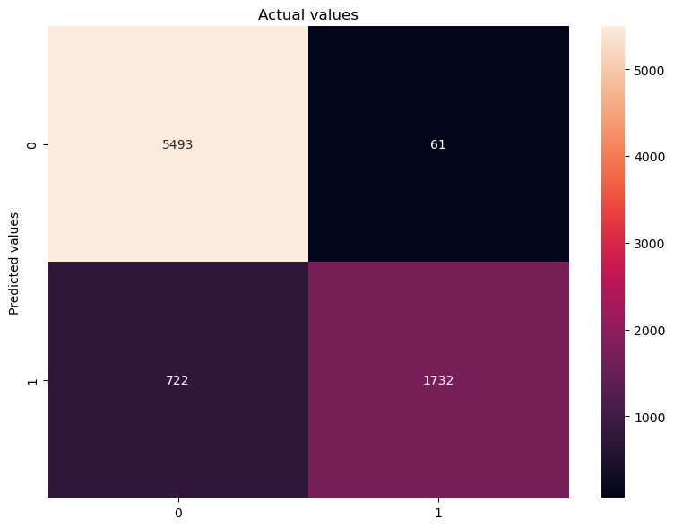

Meta-Learning Algorithms
Voting Scheme
Majority Voting
Weighted Majority
Accuracy 0.901
Accuracy 0.906
Ricard Guixaró

Slide 34
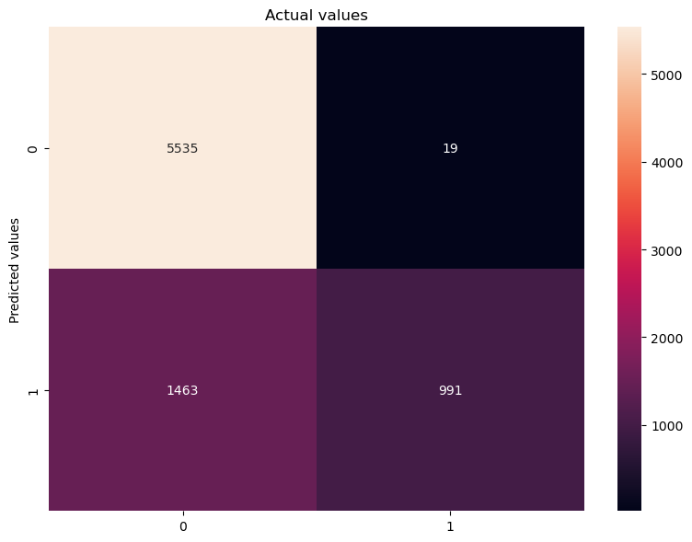
Meta-Learning Algorithms
max_features = 0.35
n_estimators = 100
Bagging
KNN
Accuracy 0.815
Ricard Guixaró

Slide 35
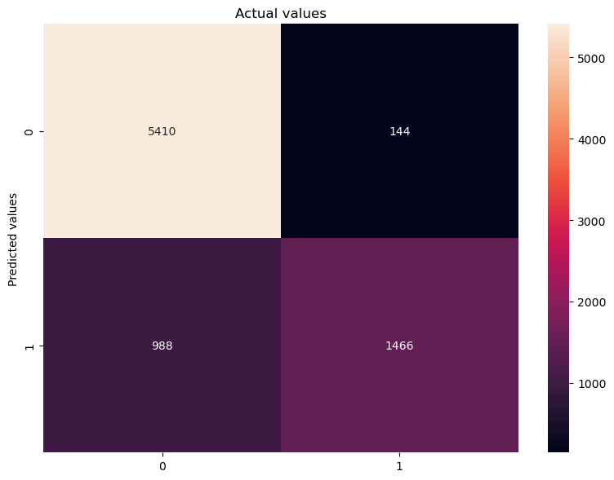

Meta-Learning Algorithms
max_features = 0.35
n_estimators = 100
Bagging
Naïve Bayes
Decision Tree
Accuracy 0.858
Accuracy 0.921
Ricard Guixaró

Slide 36

Meta-Learning Algorithms
max_features = 0.35
n_estimators = 100
RandomForest
Basic Version
Accuracy 0.928
Ricard Guixaró

Slide 37
Meta-Learning Algorithms
max_features = 0.35
n_estimators = 100
RandomForest
ExtraTreesClassifier Version
Accuracy 0.934
Ricard Guixaró

Slide 38
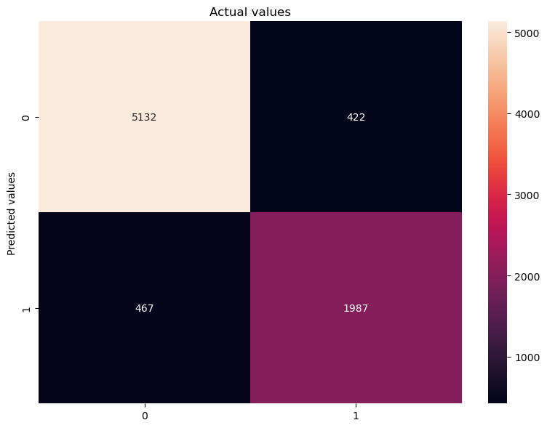
Meta-Learning Algorithms
n_estimators = 100
Boosting
Adaboost
Accuracy 0.889
Ricard Guixaró

Slide 39
Meta-Learning Algorithms
Conclusions
Voting Scheme
Both Majority and Weighted Votings obtained good and similar results
Bagging
Nice accuracy when using Decision Tree classifier, not so much for the others
RandomForest
Best Meta-Learning Algorithm, great results
Adaboost
Really poor performance compared to the others
Ricard Guixaró

Slide 40
Conclusions
High accuracy
Long execution
Importance of Preprocessing
Ramon Ribas Domingo

